Slide 1
On using Neural Networks to analyse the behaviour of C. elegans
Enrique Galceran García

Slide 2
What actually IS a Neural Network
Warren McCulloch and Walter Pitts (1943) created a computational model for neural networks based on mathematics and algorithms called threshold logic. This model paved the way for neural network research to split into two approaches:
Hebbian learning which used neural plasticity with an unsupervised learning model. With this model, Rosenblatt created the perceptrons, the first version of the modern Neural Networks.
Backpropagation: Instead of creating or removing new connections, this method distributes the error of the outputs back through the layers, modifying the weights at each node.

Slide 3
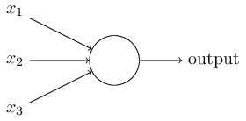
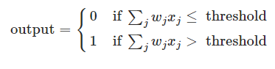
Perceptrons, the first Neural Networks
Perceptrons are an extremely simple version of what would become the neurons. It has several binary inputs and produces a single binary output.
Rosenblatt introduced the concept of weights, real numbers which express the importance of the respective inputs.
If the sum of the inputs·weights is greater than a defined threshold, the perceptron will output 1 and if it’s smaller the perceptron will output 0.

Slide 4

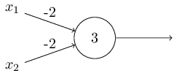
Bias and NAND gate
Using a new variable called bias, we can change the threshold so that the perceptron will change when it activates.
Combining weights and bias, we can create a simple NAND gate (00=1, 01=1, 10=1, 11=0):

Slide 5
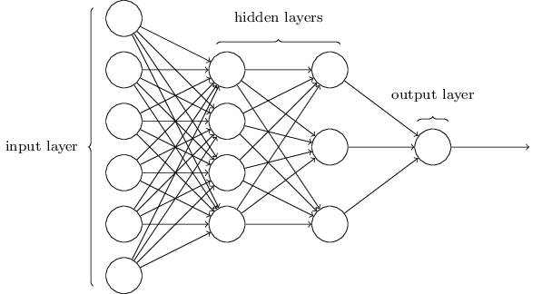
Now we can combine several perceptrons and create our primitive Neural Network, where the outputs of each layer of perceptrons will be used as inputs for the next layer of perceptrons

Slide 6
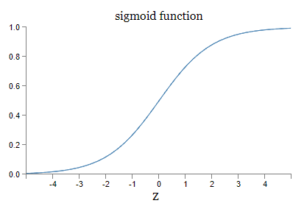
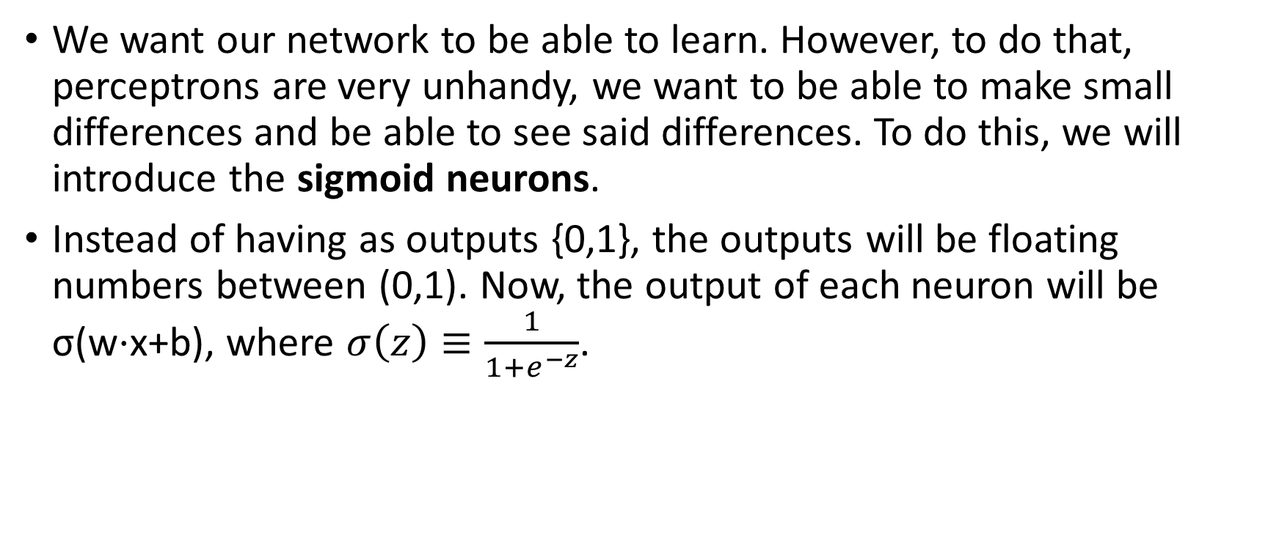
Sigmoid Neurons
We want our network to be able to learn. However, to do that, perceptrons are very unhandy, we want to be able to make small differences and be able to see said differences. To do this, we will introduce the sigmoid neurons.
Instead of having as outputs {0,1}, the outputs will be floating numbers between (0,1). Now, the output of each neuron will be σ(w⋅x+b), where $σ\left(z\right)≡\frac{1}{1+e^{−z}}$.

Slide 7
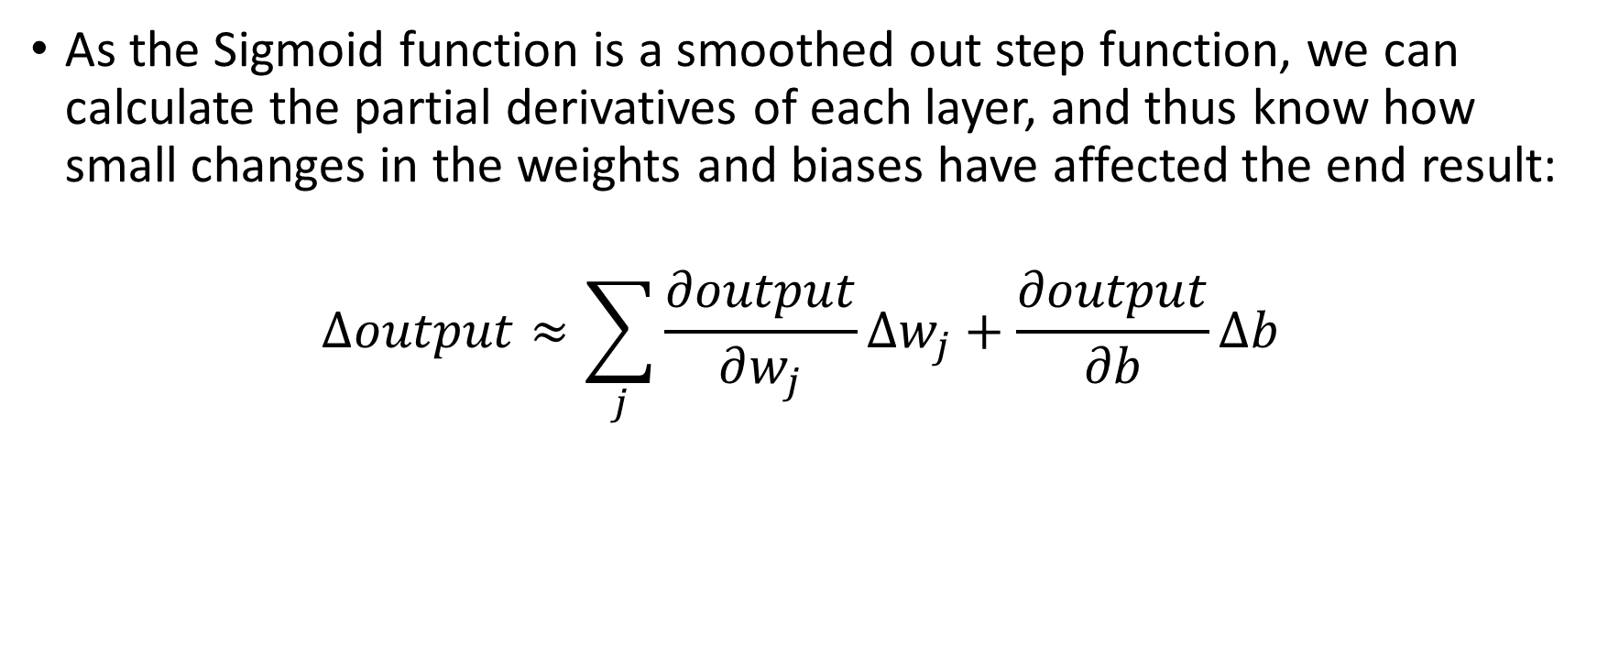
Advantage of Sigmoid neurons
As the Sigmoid function is a smoothed out step function, we can calculate the partial derivatives of each layer, and thus know how small changes in the weights and biases have affected the end result:
$$Δoutput≈\sum_{j}{\frac{∂output}{∂w_{j}}Δw_{j}+\frac{∂output}{∂b}Δb }$$

Slide 8
Cost function
Suppose we have a set of training data. This means we have a combination of inputs for which we know the output i.e. images of numbers and a label with the number represented.
If we can evaluate each pixel of the image as multiple inputs for our network, we can see what the Network thinks the output should be.
If the initial values of the weights and biases are randomized, the prediction should be extremely bad.

Slide 9

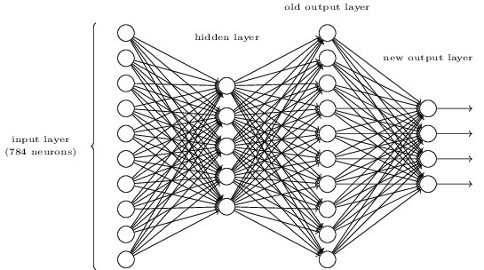

Slide 10

Cost function
The cost function quantifies how well we achieved the goal of analyzing the value of each pixel and predicted the output:
The only variables for this expression are the weights and biases. a represents the outputs of the network where x where used as inputs and y(x) are the correct labels for each input.

Slide 11
Gradient descent
Now that we know how small differences in the weights and biases could affect the outputs, we could evaluate the new cost function that would be like.
Out objective is to obtain a cost function that is as close to zero as possible. To do this we could use the gradient descent method used in finding minima and maxima in Calculus:

Slide 12

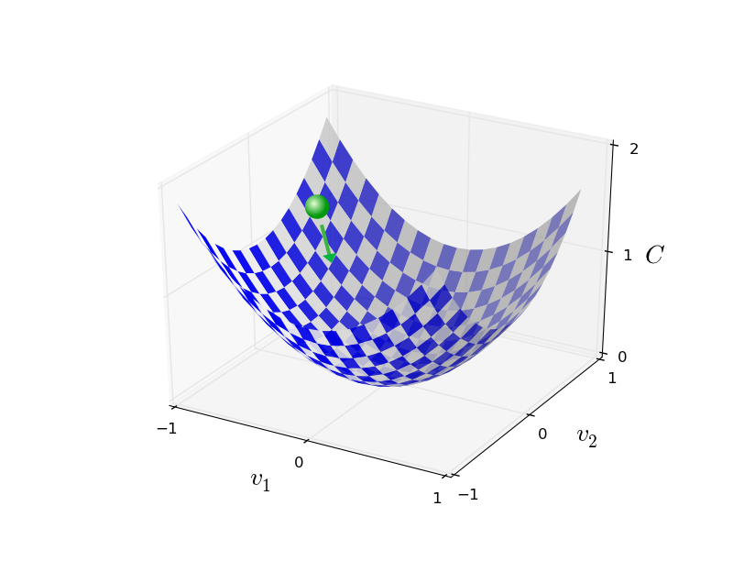
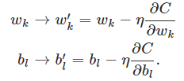
Gradient Descent

Slide 13
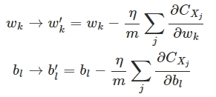
Stochastic gradient descent
After each iteration, the value of each weight and bias will have changed slightly.
Some iterations cancel each other for individual weights and biases.
Neural networks are matrix multiplications with inputs and outputs being 1-dimensional vectors.
We could combine several inputs and outputs at once, thus reducing the amount of iterations needed to reach out destination

Slide 14
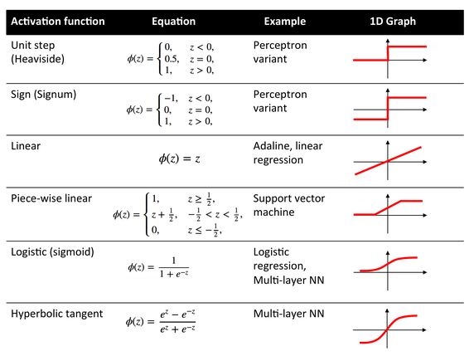
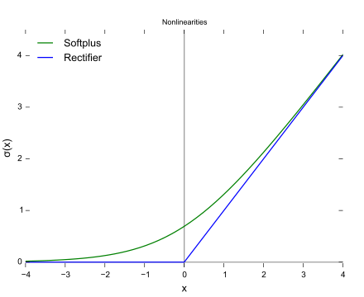
Activation functions
There isn’t only one type of neuron used in modern Neural networks. We can change the activation function σ(z) to best fit our needs:
Rectified Linear Unit (ReLU)

Slide 15
Backpropagation
Now that we have all the tools, we can actually backpropagate:

Slide 16
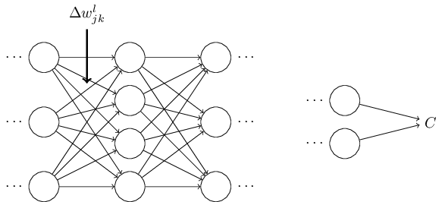

$$ΔC≈\frac{∂C}{∂w_{jk}^{l}}Δw_{jk}^{l}$$

Slide 17
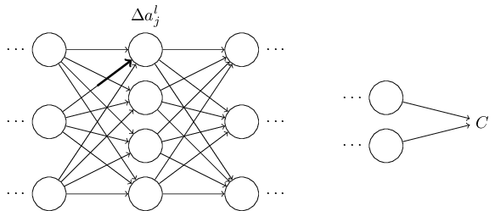

$$Δa_{j}^{l} ≈\frac{∂a_{j}^{l}}{∂w_{jk}^{l}}Δw_{jk}^{l}$$

Slide 18
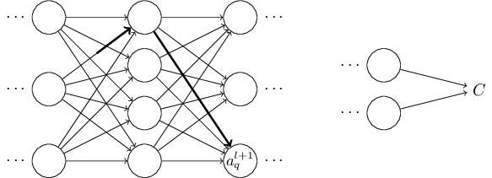
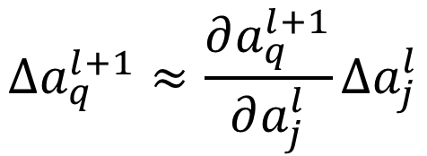
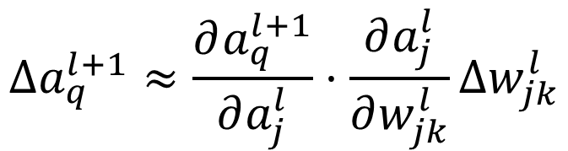
$$Δa_{q}^{l+1}≈\frac{∂a_{q}^{l+1}}{∂a_{j}^{l}}Δa_{j}^{l}$$
$$Δa_{q}^{l+1}≈\frac{∂a_{q}^{l+1}}{∂a_{j}^{l}}·\frac{∂a_{j}^{l}}{∂w_{jk}^{l}}Δw_{jk}^{l}$$

Slide 19
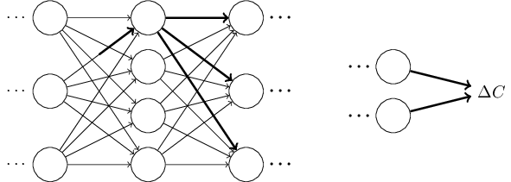
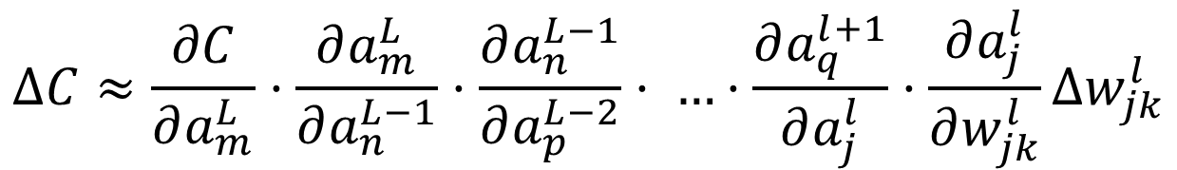
$$ΔC≈\frac{∂C}{∂a_{m}^{L}}·\frac{∂a_{m}^{L}}{∂a_{n}^{L−1}}·\frac{∂a_{n}^{L−1}}{∂a_{p}^{L−2}}· …·\frac{∂a_{q}^{l+1}}{∂a_{j}^{l}}·\frac{∂a_{j}^{l}}{∂w_{jk}^{l}}Δw_{jk}^{l}$$

Slide 20
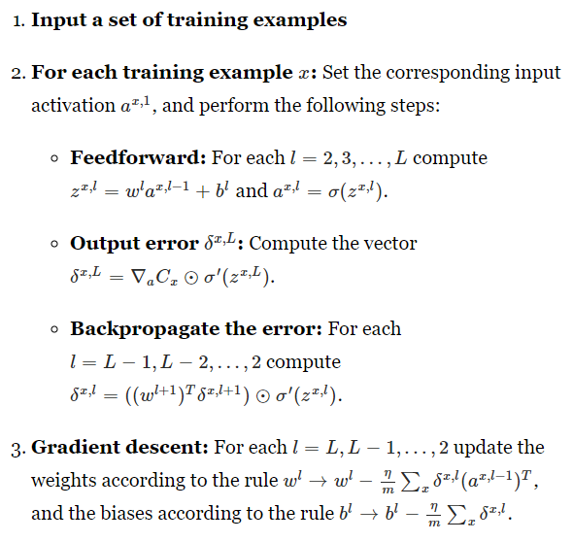
l – index of a layer of neurons and weights

Slide 21
Frecuent problems of Machine Learning & Neural Networks
Although very strong for certain tasks, it’s a very slow process and takes an enormous amount of time.
It is extremely CPU/GPU intensive. If on supercomputers it already takes a lot of time, on laptops/home computers it will take even longer to process.
Weight initialization isn’t always as simple as randomizing the weights and value. If not set correctly it will completely saturate the network.
Many of these problems can be fixed, although often require trial and error to find the best hyper-parametres.

Slide 22
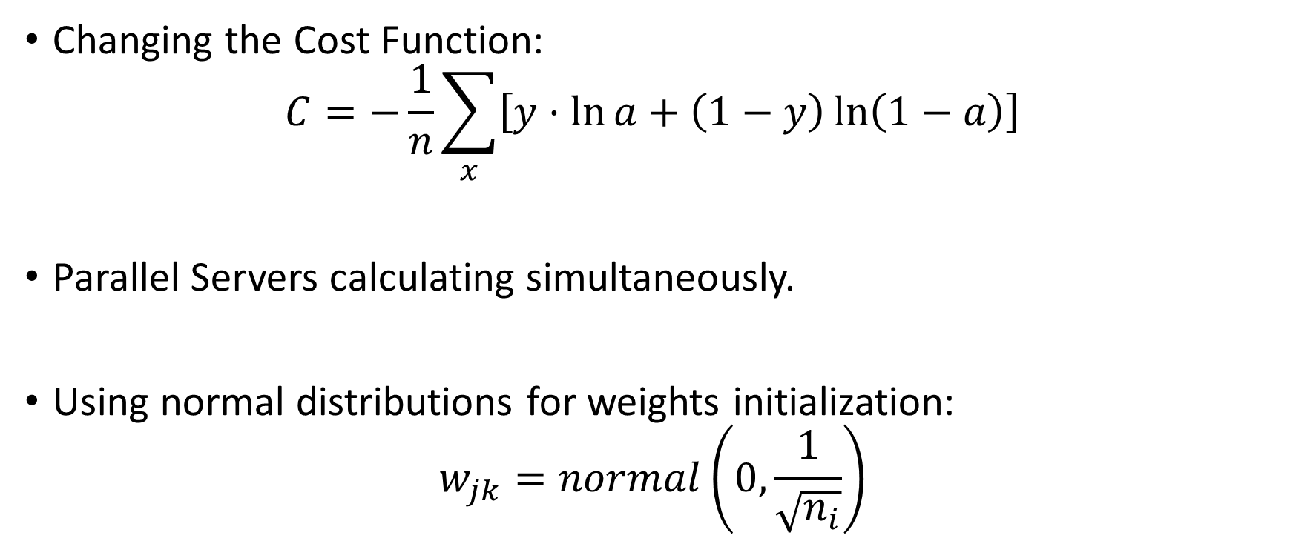
Common Solutions
Changing the Cost Function:
$$C=−\frac{1}{n}\sum_{x}{\left[y·\ln{a}+\left(1−y\right)\ln\left(1−a\right)\right]}$$
Parallel Servers calculating simultaneously.
Using normal distributions for weights initialization:
$$w_{jk}=normal\left(0,\frac{1}{\sqrt{n_{i}}}\right)$$

Slide 23
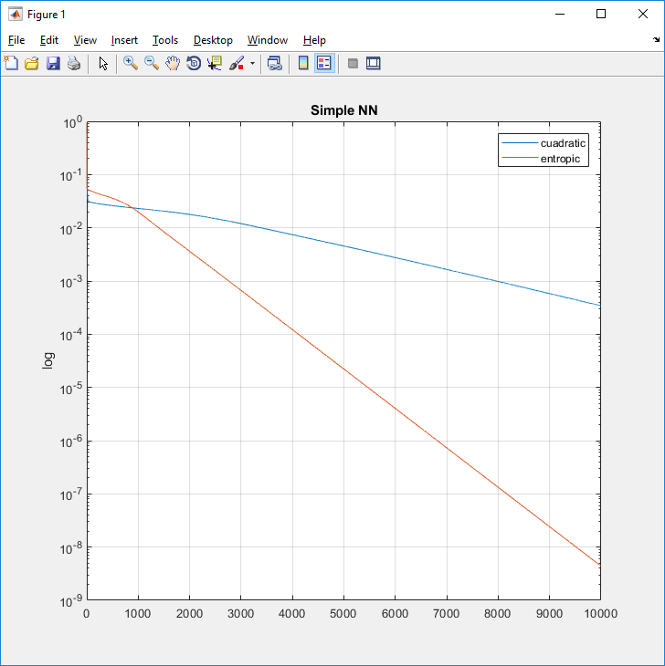
Different fitting between cuadratic and entropic

Slide 24
Vanishing Gradient problem
By far, the biggest problem that affected the networks I created.
Most treatments are worse than the disease*
The problem resides in the mathematics of backpropagating while calculating the derivatives.

Slide 25
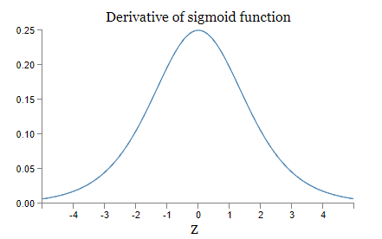
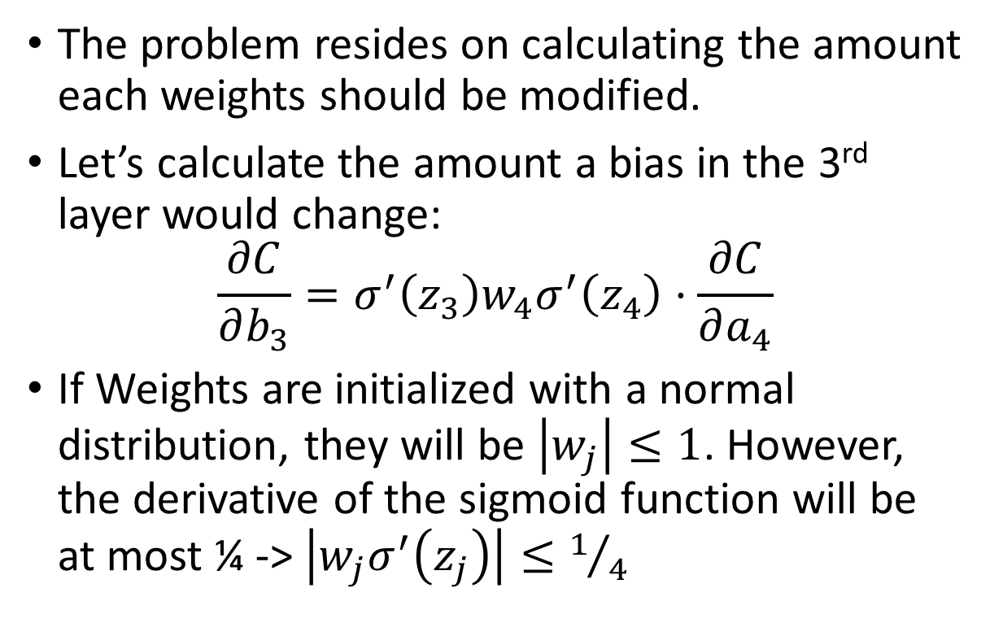
Vanishing gradient problem
The problem resides on calculating the amount each weights should be modified.
Let’s calculate the amount a bias in the 3rd layer would change:
$$\frac{∂C}{∂b_{3}}=σ^{′}\left(z_{3}\right)w_{4}σ^{′}\left(z_{4}\right)·\frac{∂C}{∂a_{4}}$$
If Weights are initialized with a normal distribution, they will be $\left|w_{j}\right|≤1$. However, the derivative of the sigmoid function will be at most ¼ -> $\left|w_{j}σ^{′}\left(z_{j}\right)\right|≤1/4$

Slide 26
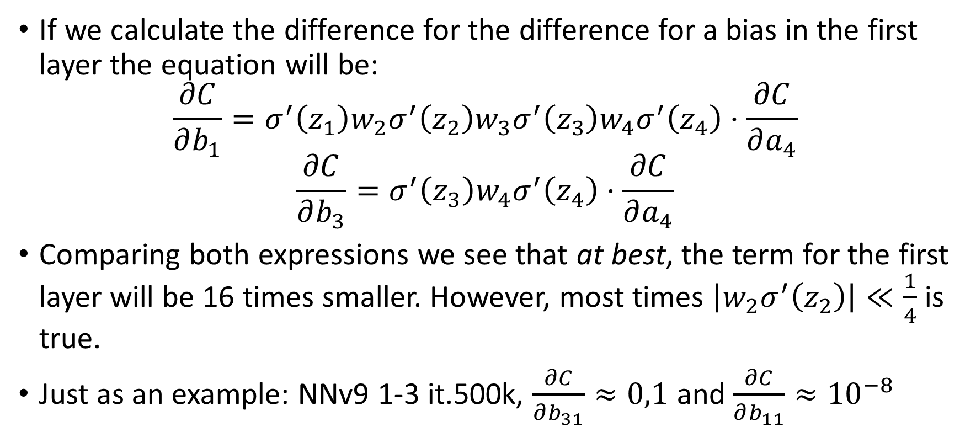
Vanishing Gradient Problem
If we calculate the difference for the difference for a bias in the first layer the equation will be:
$$\frac{∂C}{∂b_{1}}=σ^{′}\left(z_{1}\right)w_{2}σ^{′}\left(z_{2}\right)w_{3}σ^{′}\left(z_{3}\right)w_{4}σ^{′}\left(z_{4}\right)·\frac{∂C}{∂a_{4}}$$
$$\frac{∂C}{∂b_{3}}=σ^{′}\left(z_{3}\right)w_{4}σ^{′}\left(z_{4}\right)·\frac{∂C}{∂a_{4}}$$
Comparing both expressions we see that at best, the term for the first layer will be 16 times smaller. However, most times $\left|w_{2}σ^{′}\left(z_{2}\right)\right|≪\frac{1}{4}$ is true.
Just as an example: NNv9 1-3 it.500k, $\frac{∂C}{∂b_{31}}≈0,1$ and $\frac{∂C}{∂b_{11}}≈{10}^{−8}$

Slide 27
My proyect & Neural Networks

Slide 28
Prediction of movement of C. elegans
We have a huge dataset of postures that 1188 worms have described once they have been set on an agar plate.
These patterns can be compared to a collection of 90 posture templates which capture ~80% of the variance of the worms.
Combining the dataset and the templates, we can create a sequence of the different postures the worm passes through while it moves.
My objective has been to create a Neural Network that is able to make said prediction.

Slide 29
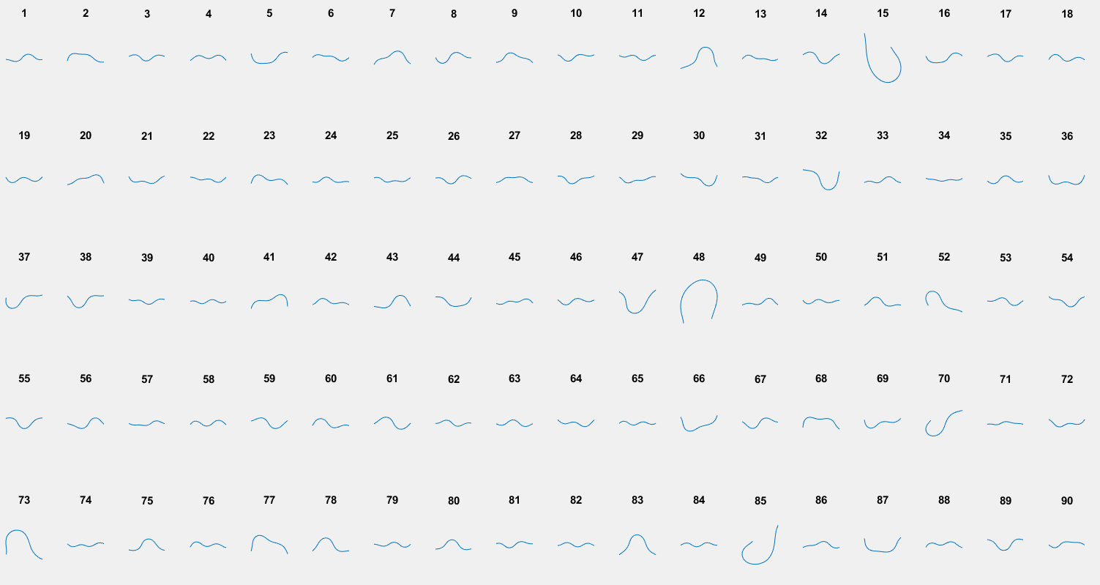

Slide 30
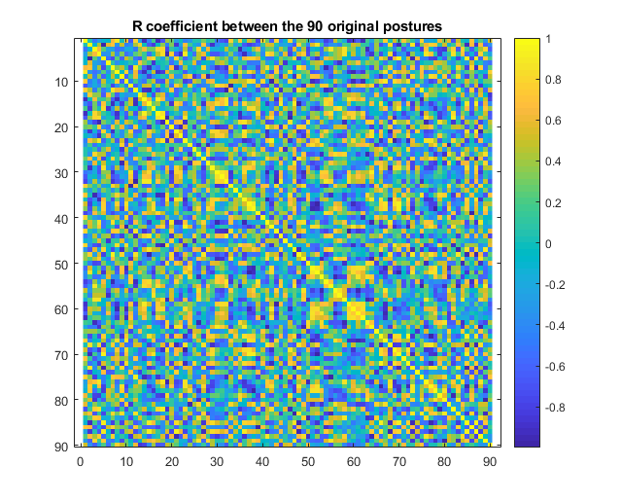
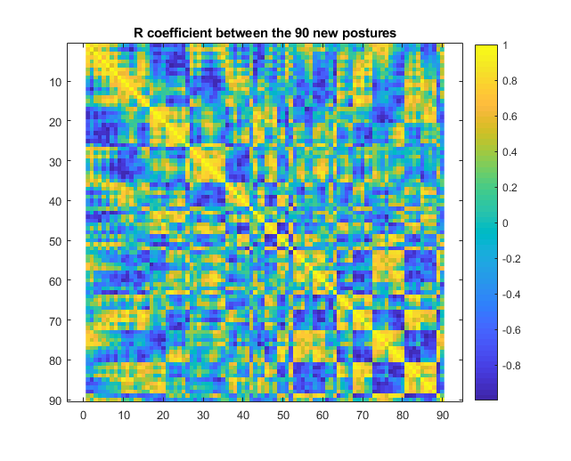
To improve the visualization of the outputs (and inputs), we sorted in the postitions

Slide 31
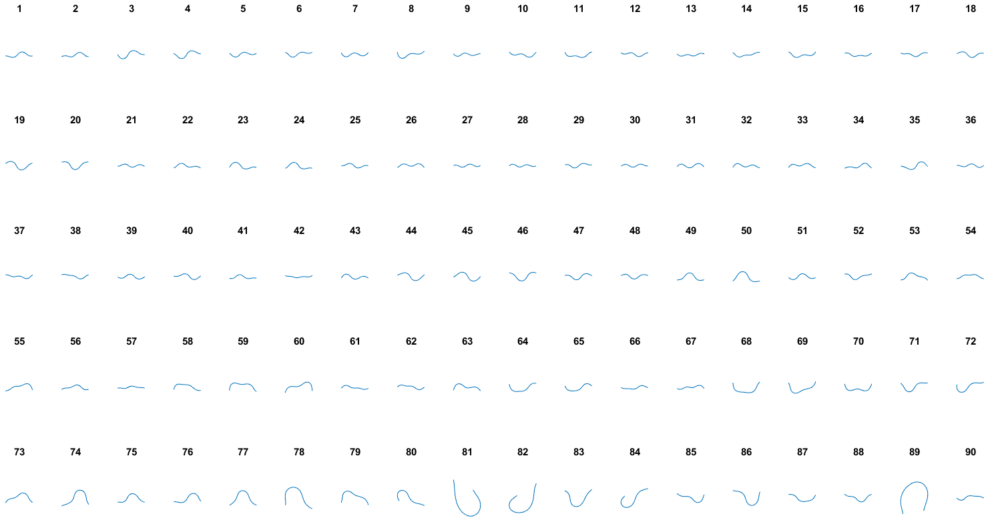

Slide 32
How does it operate?
The idea is to use the previous postures as inputs and receive as our output the next posture in the sequence.
Neural Network

Slide 33
How does it operate?
On the next iteration, the NN would take the following couple postures and predict the next output
Neural Network

Slide 34
Selecting inputs & outputs
Neural Networks work best with information described as a continuum i.e. {Hours Slept, Hours Studied} -> {Grade in a test}. However, this de our objective is using both a discrete input and a discrete output.
To fix this, we implemented the fact that we are using several “legacy-postures” as input.

Slide 35
0
0
0,5
0
1
0
90
inputs
90
outputs
0,25
0
0,13
1
0,06
0
50-80
Neurons/
layer

Slide 36
Initial Results
Bad. Very bad.
A whole day of fixing and tweaking were necessary for the first Neural Network to correctly predict with >30% success rate.
Once the problems where located, it was just a matter of trial and error before the first Networked worked as intended.

Slide 37
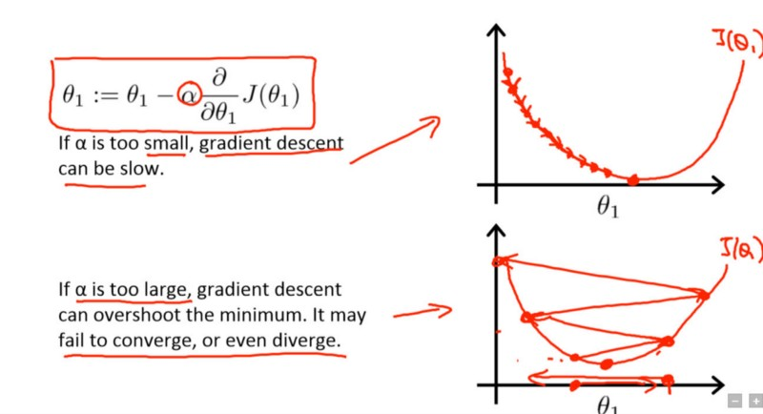
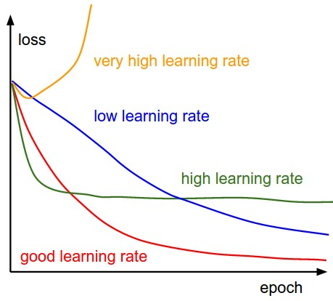
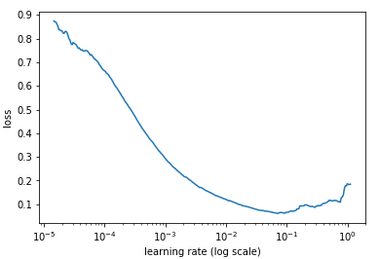
Learning Rate
One of the main problems resides on the learning rate. It modulates how much the network changes after each iteration.
https://towardsdatascience.com/understanding-learning-rates-and-how-it-improves-performance-in-deep-learning-d0d4059c1c10 for more info

Slide 38
Initial Results (II)
Creating individual networks to predict the next posture in the sequence ended being a success with individual networks (Networks that were trained only using data from a single worm) ranging from a 85%-95% depending on the size, hyperparametres and process time of the network.
On average, after 45 min these networks were able to predict with a 90% success rate for a single worm.

Slide 39
Neural Networks for multiple worms
The next step was to create a network that would be able to use as training data multiple worms. Our expectation was to be able to correctly predict all these multiple worms with a single Network.
One important aspect of Neural Networks is that although it takes a long time to train and perfect it, once it’s done, evaluating said network takes barely a couple milliseconds.

Slide 40
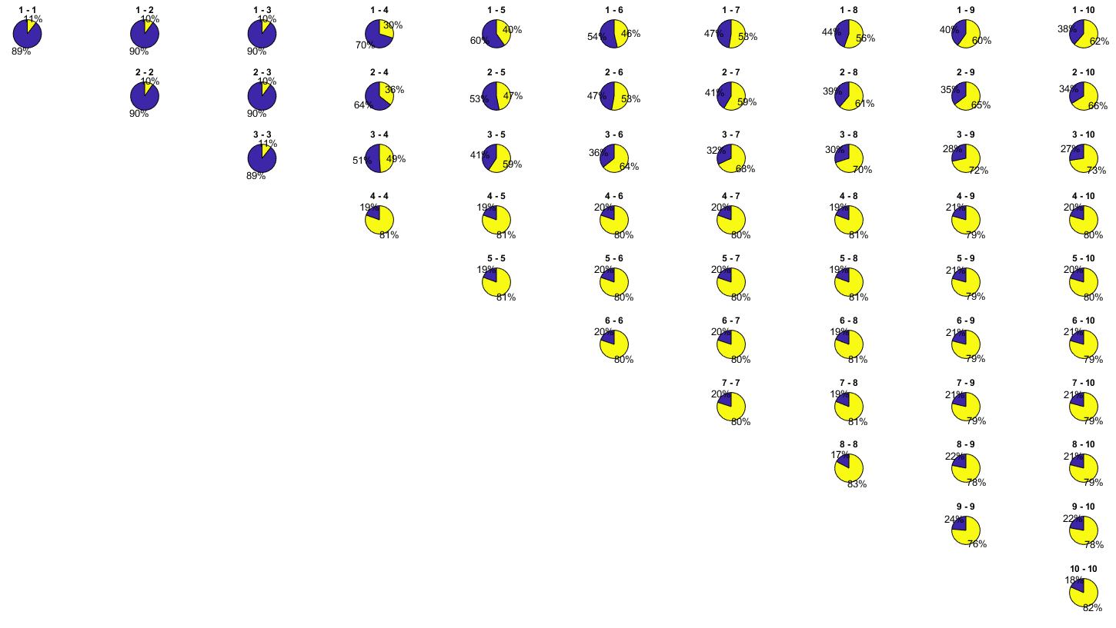
Comparing Solutions (Neural Networks)

Slide 41
Markov Chain Monte Carlo
Markov is a statistical analysis method that counts the occurrences of a specific parameter (in this case, the next posture) and creates a transition matrix that determines the probability for each transition i.e. what is the probability that if the last posture was A, the next posture will be B: P(A->B)
Monte Carlo uses the pseudorandom number generating potential of the computer and simulates many different possible outcomes (N ~1000)
Combining these two tools, we can simulate the movement of the worm and count how many times it predicted correctly.

Slide 42
Solutions for Markov
However, using Markov as a baseline for predicting the movement of worms ended up being quite disappointing. Using just the behavior of the worms individually resulted in just a 10-15% success rates (with a couple isolated occurrences of 18-19%).
When compared to other worms, Markov was clearly worse at predicting the outcome:

Slide 43
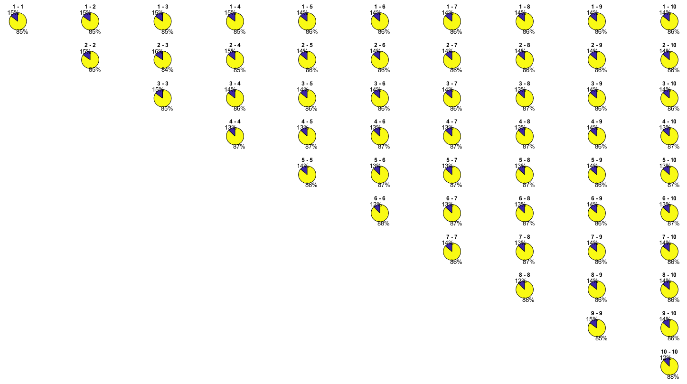
Comparing Solutions (Markov)

Slide 44
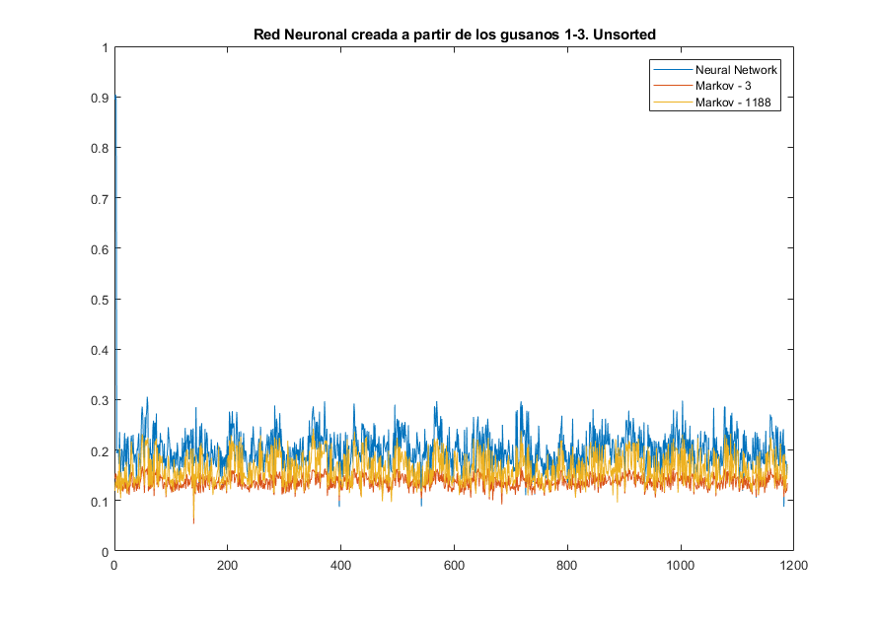
Comparing Solutions

Slide 45
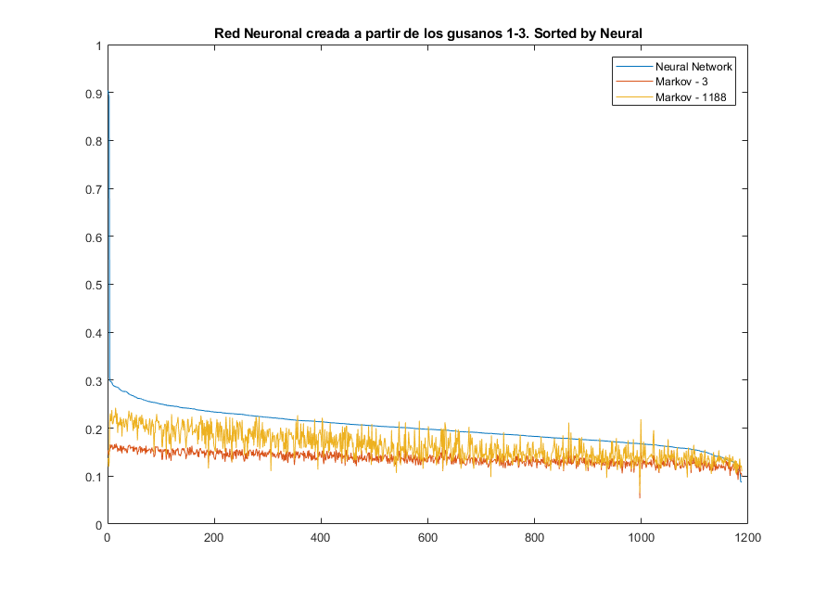

Slide 46
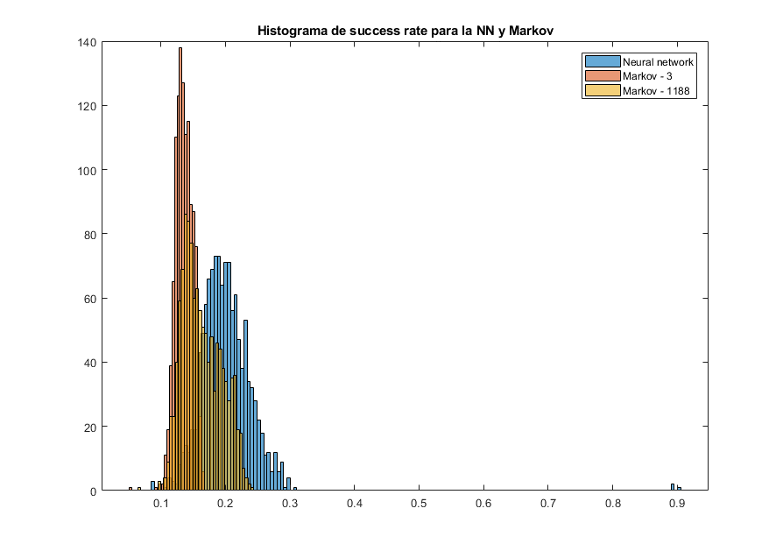

Slide 47
Currently working on
Using both methods to create a sequence of postures starting of on a small seed (taken from the data) and letting if unfold without further input.
Preliminary results indicates that the neural Network sometimes gets stuck between 2-3 positions and will cycle between them. Due to the random aspect of the MCMC method, this does not occur.
Passing these computer generated sequences through a compression algorithm and comparing these with the compression of the empirical data.

Slide 48
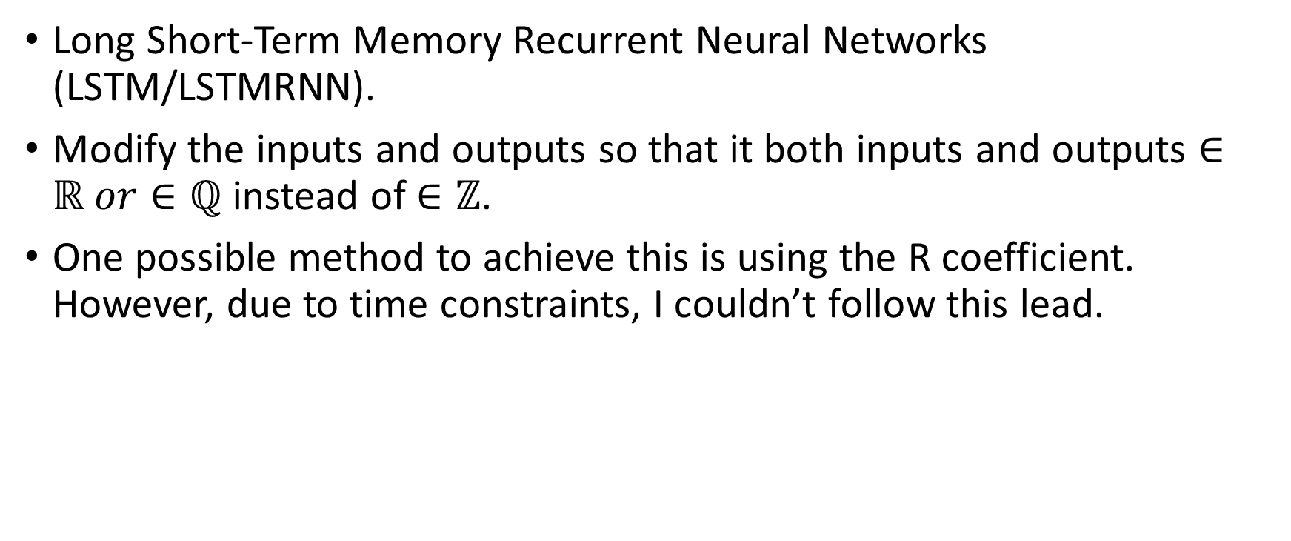
Possible improvements
Long Short-Term Memory Recurrent Neural Networks (LSTM/LSTMRNN).
Modify the inputs and outputs so that it both inputs and outputs $∈ℝ or∈ℚ$ instead of $∈ℤ$.
One possible method to achieve this is using the R coefficient. However, due to time constraints, I couldn’t follow this lead.

